Slide 1

2023 Travelers Analytics Case Competition
InsNova Auto Insurance Company Modeling Problem
Team: Traveling Scientists (Rutgers University)

Slide 2
Team members
Rishik Salver
Ganesh Raj Kyatham
Yuyue Sun
Xinran Zhao
Vishnuram Jatin Bangaru

Slide 3

Introduction
Create a rating plan based on the historical auto claim data, predicting the claim cost for each policy.

Slide 4
Data
Policyholder demographics
Vehicle information
Claim policy
Age, gender, area, driving history, credit scores, marital status, education level
Financial value, physical type, engine, maximum power, year, safety ratings
Risk exposure, electronic billing, term length, numbers of claims made

Slide 5
Data
In total, the training dataset contains over 22,000 individual policy records (including 22 variables) spanning from 2004 to 2005, 6.8% had at least one claim, providing a rich foundation for our analysis.
Validation data is similar to the training data but two variables have been removed.

Slide 6
Exploratory Data Analysis
To understand data better, we employed a variety of exploratory data analysis techniques, including:
Visualization of claim data to identify patterns and trends.
Descriptive statistics to summarize claim data and identify outliers or missing values.
Correlation analysis to identify relationships between claim variables and potential contributing factors.

Slide 7
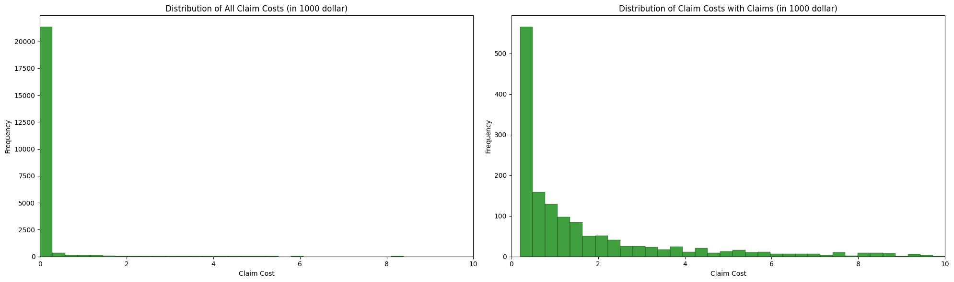
Exploratory Data Analysis
For policy with at least one claim:
The average claim cost is $2391.69.
75% of claims have a cost of less than $2408.52.

Slide 8
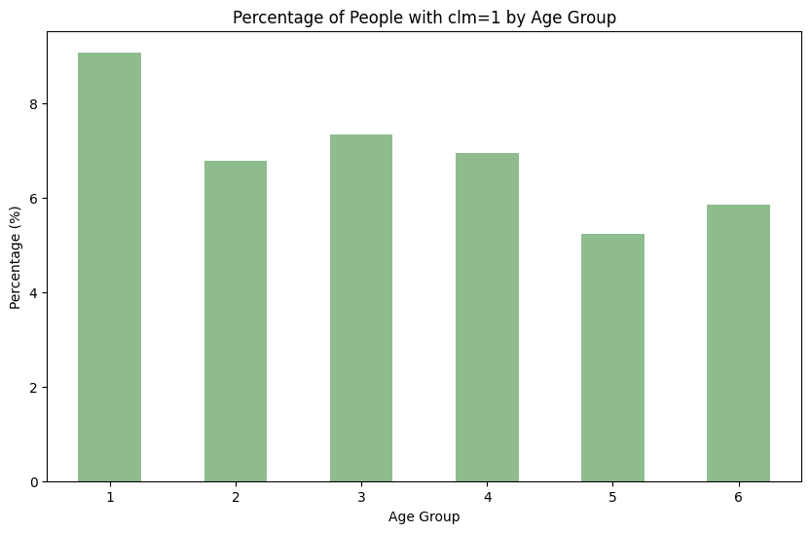
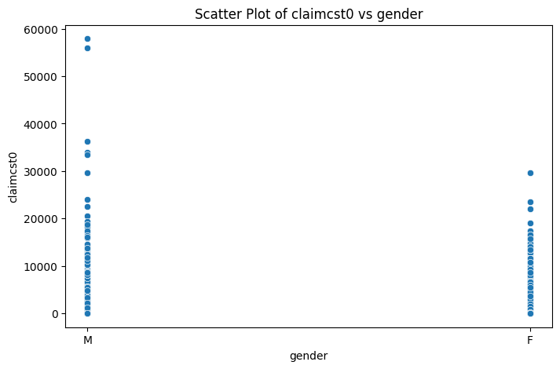
Exploratory Data Analysis

Slide 9
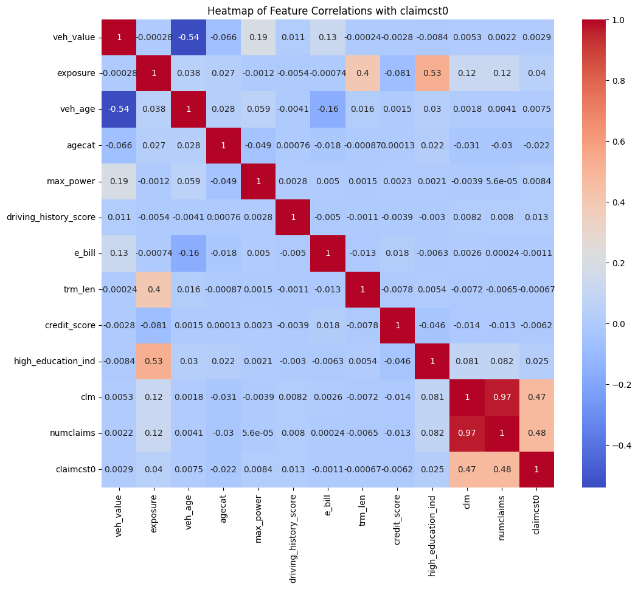
Exploratory Data Analysis
Investigating the relationships between different variables and their impact on claim costs. – getting rid of high correlation variables and irrelevant variable

Slide 10
Model - Data preparation
Categorical Feature Treatment:
Encoding: We transformed categorical variables using one-hot encoding for nominal variables and ordinal encoding where a natural order existed.
Numerical Feature Treatment:
Standardization: We scaled numerical features to ensure that variables with larger ranges do not dominate the model's feature importance.

Slide 11
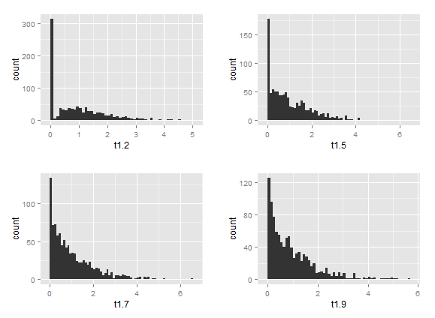
Tweedie Model
We used Tweedie distribution to model our data.
Tweedie is a statistical distribution suited for modeling insurance claim costs as it handles data with excess zeros and right-skewed distribution
Insurance data often has many policies with no claims (zeros) and a few high-cost claims, making Tweedie a suitable choice

Slide 12
Model Approaches
We tried out multiple approaches to predict the claim cost. Here are few for which we did not get good predictions:
Predicted is_clm and appended it into the validation data to predict claim cost using Ensemble and Boosting Algorithms
Passing the Tweedie Regressor as an objective function to the boosting algorithms.
Passing exposure as the offset and modelling the pure premium.
Using variable selection using L1 norm.
TD boost - A very powerful model but given the time constraint couldn’t leverage its full potential
Models that did give good predictions:
Simple Tweedie Regressor using Tweedie Mean Deviance scorer.
Employed grid search to enhance predictive accuracy by exploring a broader range of parameters.

Slide 13
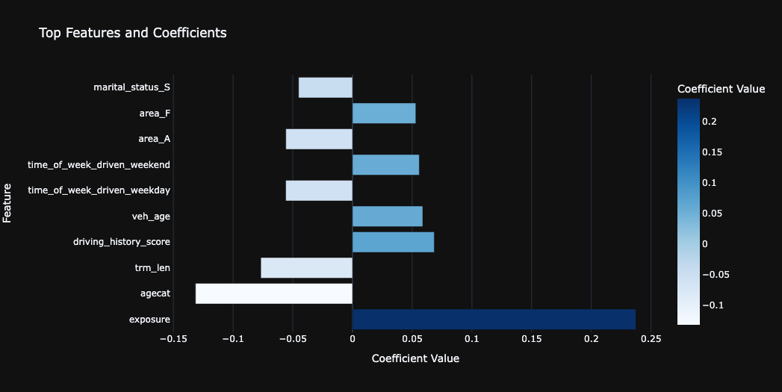
About the Model
Pipelined the Tweedie model with the preprocessing mentioned before and conducted grid search to find out the optimal hyperparameters for the Tweedie Regressor.
Applied lower and upper bounds to the predictions to enhance model stability and prevent extreme values.
Implemented the best model obtained on the validation data to generate predictions for auto insurance claim costs.

Slide 14
Fit Statistics and Performance Metrics
Gini index is used as a key metric for model performance.
Gini coefficient close to 1 indicates good model performance, whereas a coefficient close to 0 indicates poor performance.
Overfitting is typically evaluated by comparing performance on training data versus unseen test data.
To prevent overfitting, training data is further split into training and test sets, allowing the evaluation of the model's generalisation to new, unseen data.

Slide 15
Model tuning
The predictive model was fine-tuned based on the evaluation results to improve its performance and accuracy.
Range of Parameters:
Tweedie Regressor, the power and alpha parameters.
Broad Range Initial Search:
Initially, set a broad range for the parameters.
Refinement:
Based on the analysis, refine the parameter ranges.
Dense Grid in Targeted Areas:
Within the narrowed ranges, increase the density of the grid.
Compare Models:
Using our gini index metric, with allowed computational feasibility.

Slide 16
Why our plan
Improved accuracy: Our model uses advanced machine learning algorithms to analyze data and provide reliable & accurate predictions of claim costs, reducing the risk of overpaying or underpaying claims.
Increased efficiency: By accurate and quicker assessment of potential claims and automating the claim prediction process, insurers can save time and resources while improving their overall efficiency and profitability.
Better decision-making: With accurate predictions of claim costs, insurers can make informed decisions about setting premiums and risk management, improving overall profitability and competitiveness.

Slide 17

Conclusion
Our model:
Tweedie Regressor using Tweedie Mean Deviance scorer
Performance:
Benchmark | 0.18029 (50% data) | 0.13483 (other 50%)
Tweedie | 0.17958 | 0.21841
Future work:
Smarter algorithms
Data drift
Broader sources
Other Variables - Occupation, Weather Impact, Car Features

Slide 18
Thanks for your attention!
Kaggle. (2023). Travelers University Competition: Leaderboard. Retrieved from https://www.kaggle.com/competitions/2023-travelers-university-competition/leaderboard?tab=public
Y. LeCun, L. Bottou, Y. Bengio, & P. Haffner. (2015). Gradient-Based Learning Applied to Document Recognition. arXiv preprint arXiv:1508.06378. Retrieved from https://arxiv.org/pdf/1508.06378.pdf
ResearchGate. (2018). Combining Predictions of Auto Insurance Claims. Retrieved from https://www.researchgate.net/publication/327280173_Combining_Predictions_of_Auto_Insurance_Claims
Rahim, W. A. (Date of Publication). Modelling Insurance Claims Data Using the Tweedie Approach. Medium. Retrieved from https://medium.com/@wardarahim25/modelling-insurance-claims-data-using-the-tweedie-approach-94db8b14bfb5
Scikit-learn developers. (n.d.). Generalized Linear Regression With a Tweedie distribution. scikit-learn. Retrieved from https://scikit-learn.org/stable/auto_examples/linear_model/plot_tweedie_regression_insurance_claims.html
Yang, Y. (n.d.). Actuarial Science at McGill University - Demonstration. McGill University. Retrieved from https://www.math.mcgill.ca/yyang/demo.html#results

